Slide 1
Reinforcement Learning

Slide 2
Presented to:
Dipanita Saha
Assistant Professor of IIT,NSTU
Presented By:
Nishat tasnim(06)
Mynuddin(07)

Slide 3
Contents
Reinforcement Learning
Agent
Passive Reinforcement Learning
MVC
(4*3) World design

Slide 4
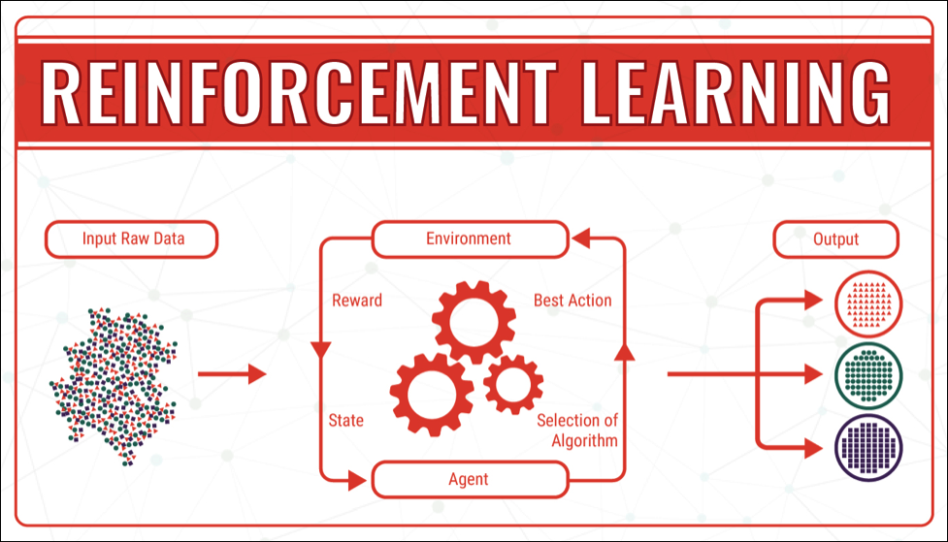
Reinforcement Learning
Reinforcement learning is the training of machine learning models
to make a sequence of decisions

Slide 5
Agent Design
1.Utility Based Agent :Select actions to maximize the utility.
Ex.Route finding by reducing distance and increase comfort
2.Q learning agent: Find the best action to take given the current state.
Ex.Take left or right direction based on traffic.
3.Reflex agent : Maps directly from state to actions.
Ex.Vaccum cleaner clean based on dust.

Slide 6
Components
1.Policy : Agents behavior function maps from state to actions.
2.Value: Prediction of future rewards evaluate good/bad.
3.Model: Predicts what the environment will do next.

Slide 7
Types
1.Passive Learning :Agent policy is fixed learn utilities of states learning a model of the environment.
Example :Students listening lectures,seeing notes.
2.Active Learning:Agent learn what to do exploration by experience.
Example: Lab/Project Work Active agent must decide what actions to take.
First,the agent will need to learn a complete model with outcome probabilities for all actions,
Next,we need to take into account the fact that the agent has a choice of actions. Agent can extract an optimal action by one step look ahead to maximize the expected utility ; alternatively, if it uses policy iteration.

Slide 8
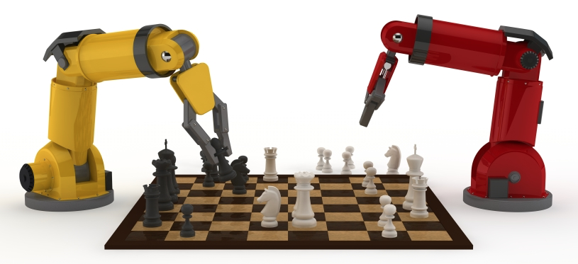
Passive Reinforcement Learning
Passive reinforcement learning is when an agent want to learn about the utilities of various states under a fixed policy.
As the goal of the agent is to evaluate how good an optimal policy is, the agent needs to learn the expected utility U^{π}(s) for each state s.

Slide 9
Markov decision processes (MDP)
Agent
State
Reward
Action
Environment

Slide 10
Cont..
Fully observable environment
The agent’s policy π is fixed
State s, new state s`
Executes the action π(s)
Utility function U^{π}(s)
Reward function R(s)
Agent does not know the transition model P(s’| s, a)

Slide 11
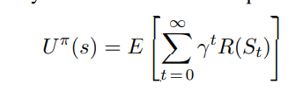
Cont..
Where R(s) is the reward for a state, S_{t} (a random variable) is the state reached at time t when executing policy π, and S₀ = s. We will include a discount factor γ in all of our equations, but for the 4 × 3 world we will set γ = 1.

Slide 12
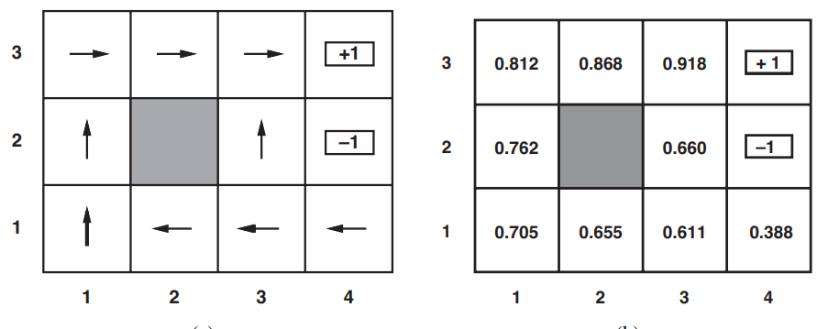
(4*3) world Example of PRL
Reward
Penalty
A policy π for the 4 × 3 world; this policy happens to be optimal with rewards of R(s) = − 0.04 in the nonterminal states and no discounting. (b) The utilities of the states in the 4 ×3 world, given policy π.

Slide 13
Cont..
The agent executes a set of trials in the environment using its policy π.
(1, 1)_{-.04}--->(1, 2)_{-.04}-->(1, 3)_{-.04}-->(1, 2)_{-.04}-->(1, 3)_{-.04}-->(2, 3)_{-.04}-->(3, 3)_{-.04}-->(4, 3)+1
(1, 1)_{-.04}-->(1, 2)_{-.04}-->(1, 3)_{-.04}-->(2, 3)_{-.04}>(3, 3)_{-.04}-->(3, 2)_{-.04}-->(3, 3)_{-.04}-->(4, 3)+1
(1, 1)_{-.04}-->(2, 1)_{-.04}-->(3, 1)_{-.04}-->(3, 2)_{-.04}-->(4, 2)-1

Slide 14
Direct utility estimation
The idea is the utility estimation of a state is the expected total reward from that state onward (called the expected reward-to-go), and each trial provides a sample of this quantity for each state visited.
Example:
The first trial in the set of three given earlier provides a sample total reward of 0.72 for state (1,1), two samples of 0.76 and 0.84 for (1,2), two samples of 0.80 and 0.88 for (1,3)

Slide 15
Utility estimation
(1, 1)_{-.04}--->(1, 2)_{-.04}-->(1, 3)_{-.04}-->(1, 2)_{-.04}-->(1, 3)_{-.04}-->(2, 3)_{-.04}-->(3, 3)_{-.04}-->(4, 3)+1
(1,1): (-.04*7)+1=0.72
(1, 2)_{-.04}-->(1, 3)_{-.04}-->(1, 2)_{-.04}-->(1, 3)_{-.04}-->(2, 3)_{-.04}-->(3, 3)_{-.04}-->(4, 3)+1
(1,2): (-.04*6)+1=0.76
(1, 2)_{-.04}-->(1, 3)_{-.04}-->(2, 3)_{-.04}-->(3, 3)_{-.04}-->(4, 3)+1
(1,2): (-.04*4)+1=0.84
(1, 3)_{-.04}-->(2, 3)_{-.04}-->(3, 3)_{-.04}-->(4, 3)+1
(1,3): (-.04*3)+1=0.88
(1, 3)_{-.04}-->(2, 3)_{-.04}-->(3, 3)_{-.04}-->(2, 3)_{-.04}-->(3, 3)_{-.04}->(4, 3)+1
(1,3): (-.04*5)+1=0.80

Slide 16
Thank You..

